Slide 1
Cost / Benefit Analysis Chapter -8 (E.M. Awad’s Book)

Slide 2
Cost/Benefit Analysis
Developing an IT application is an investment. Since after developing that application it provides the organization with profits.
Profits can be:
Monetary
In the form of an improved working environment.
However, it carries risks, because in some cases an estimate can be wrong. And the project might not actually turn out to be beneficial.
Cost Benefit Analysis helps to give management a picture of the costs, benefits and risks. It usually involves comparing alternate investments.

Slide 3
Cost/Benefit Analysis Contd…
Cost benefit determines the benefits and savings that are expected from the system and compares them with the expected costs.
The cost of an information system involves:
Development Cost
Maintenance Cost.
The development costs are one time investment whereas maintenance costs are recurring. The development cost is basically the costs incurred during the various stages of the system development.

Slide 4
Cost and Benefit Categories
Cost Benefit Analysis (CBA) is important to identify cost and benefit factors. Cost and benefits can be categorized into the following categories.

Slide 5
Classification of Costs
Hardware/software costs:
It includes the cost of purchasing or leasing of computers and it's peripherals. Software costs involves required software costs.
Personnel costs:
It is the money, spent on the people involved in the development of the system. These expenditures include salaries, other benefits such as health insurance, conveyance allowance, etc.
Facility costs:
Expenses incurred during the preparation of the physical site where the system will be operational. These can be wiring, flooring, lighting, and air conditioning.

Slide 6
Classification of Costs Contd…
Operating costs:
Operating costs are the expenses required for the day to day running of the system. This includes the maintenance of the system. That can be in the form of maintaining the hardware or application programs or money paid to professionals responsible for running or maintaining the system.
Supply costs:
These are variable costs that vary proportionately with the amount of use of paper, ribbons, disks, and the like. These should be estimated and included in the overall cost of the system.

Slide 7
Benefits
We can define benefit as Profit or Benefit = Income - Costs
Benefits can be accrued by :
- Increasing income, or - Decreasing costs, or - Both
The system will provide some benefits also. Benefits can be tangible or intangible, direct or indirect. In cost benefit analysis, the first task is to identify each benefit and assign a monetary value to it.
The two main benefits are improved performance and minimized processing costs.

Slide 8
Costs & Benefits can be Categorized As
Tangible or Intangible Costs and Benefits
Direct or Indirect Costs and Benefits
Fixed or Variable Costs and Benefits

Slide 9
Tangible or Intangible Costs and Benefits
Tangible cost and benefits can be measured. Hardware costs, salaries for professionals, software cost are all tangible costs.
They are identified and measured.. The purchase of hardware or software, personnel training, and employee salaries are example of tangible costs.
Costs whose value cannot be measured are referred as intangible costs. The cost of breakdown of an online system during banking hours will cause the bank lose deposits.
Benefits are also tangible or intangible. For example, more customer satisfaction, improved company status, etc are all intangible benefits.
Whereas improved response time, producing error free output such as producing reports are all tangible benefits. Both tangible and intangible costs and benefits should be considered in the evaluation process.

Slide 10
Direct or Indirect Costs and Benefits
From the cost accounting point of view, the costs are treated as either direct or indirect. Direct costs are having money value associated with it. Direct benefits are also attributable to a given project. For example, if the proposed system that can handle more transactions say 25% more than the present system then it is direct benefit.
Indirect costs result from the operations that are not directly associated with the system. Insurance, maintenance, heat, light, air conditioning are all indirect costs.

Slide 11
Fixed or Variable Costs and Benefits
Some costs and benefits are fixed. Fixed Costs don't change. Ex. Straight line depreciation of hardware, Insurance, etc are all fixed costs.
Variable costs are incurred on regular basis. Recurring period may be weekly or monthly depending upon the system. They are proportional to the work volume and continue as long as system is in operation. Ex. the cost of computer forms vary in proportion to the amount of processing or the length of the report required.
Fixed benefits don't change. Variable benefits are realized on a regular basis.

Slide 12
Fixed or Variable Costs and Benefits condt…
Fixed benefits don't change. Ex. Decrease in the number of personal by 20% resulting for the use of a new computer.
Variable benefits are realized on a regular basis. Ex. Consider a safe deposit tracking system that save 20 minutes preparing customer notices compared with the manual system. The amount of time saved varies with the number of notices produced.

Slide 13
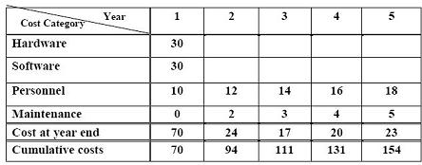
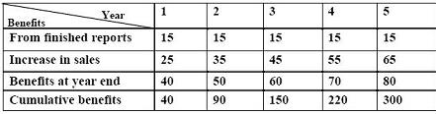
Performing Cost Benefit Analysis (CBA)
Cost for the proposed system ( figures in US Dollars and in thousand)
Benefit for the propose system
Profit = Benefits - Costs = 300, 000 -154, 000 = USD 146, 000

Slide 14
Cost/Benefit Analysis Techniques
Net Benefit Analysis
Present value Analysis
Net Present Value
Payback Analysis
Break-Even Analysis
Cash-Flow analysis

Slide 15
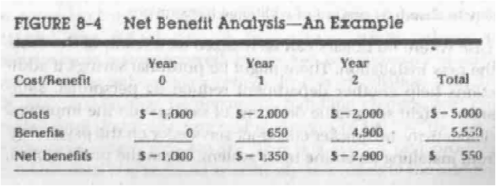
Net Benefit Analysis
Simply Subtracts total cost from total benefit.
Easy to calculate, interpret and present.
Does not account for the time value of money. [drawback]
In figure 8.4: Negative number represent the cash outlays. Period 0 represent the present period.

Slide 16
Net Benefit Analysis
The time value of money is usually expressed in the form of interest on the funds invested to realize the future value.
Formula for the compounded interest (formula for the future value):
F = P(1+i)^{n}
F: future value of an investment
P: present value of an investment
i: Interest rate per compounding rate
n: Numbers of years
For example, TK 3,000 invested in Treasury notes for three years at 10 percent interest would have a value at maturity of TK 3,993.

Slide 17
Present Value Analysis
It is used for long-term projects where it is difficult to compare present costs with future benefits. In this method cost and benefit are calculated in term of today's value of investment.
To compute the present value, we take the formula for future value,
F = P(1+i)^{n}
=> P = F/ (1+i)n [Formula to calculate present value]
Example: Present value of $3000 invested at 15% interest at the end of 5th year is 1491.53
Notes:
calculates as
P = 3000/(1 + .15)5 = 1491.53

Slide 18
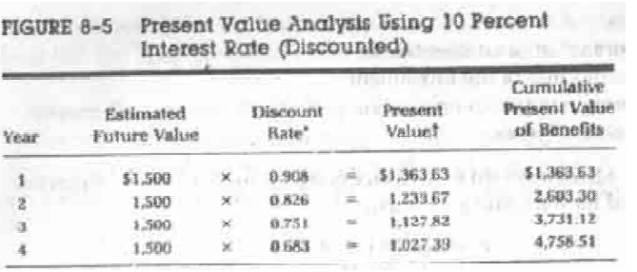
Present Value Analysis
Discount rate – a percentage similar to interest rates that you earn on your savings.
In most cases the discount rate for a business is the opportunity cost of being able to invest money in other projects or investments
Notes:
calculates as
P = 3000/(1 + .15)5 = 1491.53

Slide 19
Net Present Value
The net present value is equal to discounted benefits minus discounted costs. It is expressed as a percentage of the investment.
Net Present Value= Discounted Benefits – Discounted Costs
% = Net Present Value/Investments
Example: A TK 50,000 investment yields a cumulative benefit of TK 80,000, or a net present value TK 30,000.
Then Net Present Value = $(80000 - 50000) = $30000
% = 30000/50000 =0.6 percent

Slide 20
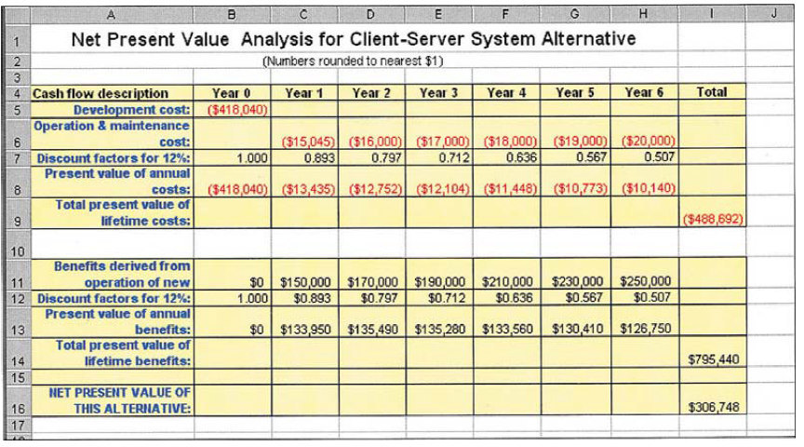
Net Present Value

Slide 21
Time Value of Money
Used with all three cost-effectiveness techniques.
Concept that recognizes that a dollar today is worth more than a dollar one year from now.
Invest $100 at 2% for one year yields $102.
So $100 today and $102 one year from today represent the same value.
Given $20,000 benefit from information system two years from now and 10% return from other investments, means that benefit is worth $16,528 today.

Slide 22
Pay Back Analysis
It determines the time it takes for the accumulated benefits to equal the initial investment
The shorter the payback period, the sooner a profit is realized and the more attractive is investment
It does not allow the time value of money

Slide 23
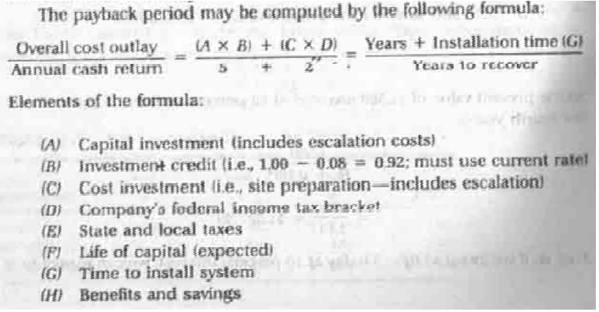
Pay Back Analysis

Slide 24
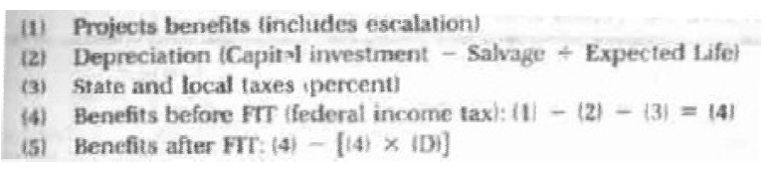
Pay Back Analysis

Slide 25
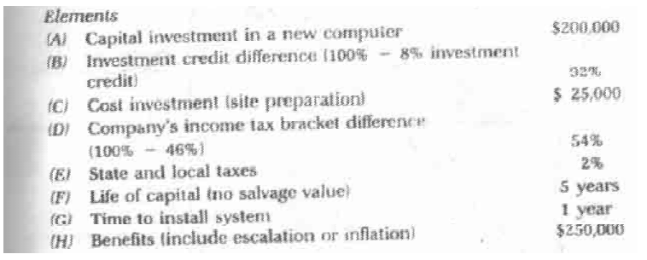
Pay Back Analysis: Example

Slide 26
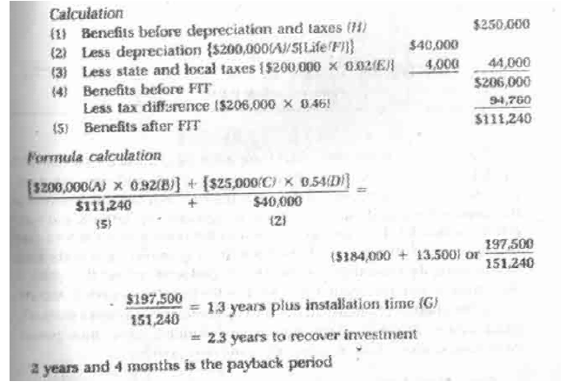
Pay Back Analysis:Example

Slide 27
Break-Even Analysis
Break-even is the point where the cost of the candidate system and that of the current one are equal.
Payback analysis method compares costs and benefits of the candidate system, where break-even analysis method compares the cost of the current and candidate systems.

Slide 28
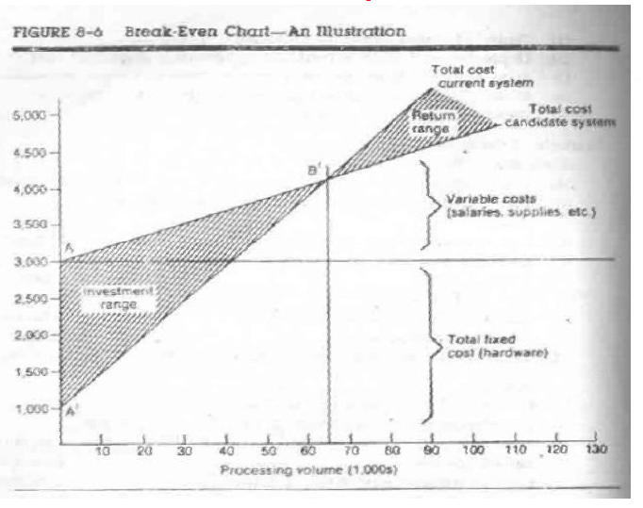
Break-Even Analysis

Slide 29
Cash-flow Analysis
Some projects, such as those carried out by computer and word processors services, produce revenues from an investment in computer systems. Cash-flow analysis keeps track of accumulated costs and revenues on a regular basis.
Figure 8.7

Slide 30
Advantages and Disadvantages of each Evaluation Methods
MUST READ @Home: Figure 8.8

